Slide 1


Accenture
Social Buzz Analytics

Slide 2


TODAY'S AGENDA
Project Recap
Problem
The Analytics Team
Process
Insights
Summary

Slide 3

Social Buzz is a Social media & content creation industry founded in 2010 and it has around 250 number of employee, has head quarter in San Francisco.
They have scaled quicker than anticipated and need the help of an advisory firm to oversee their scaling process effectively.
To start our engagement with Social Buzz, we are running a 3 month initial project in order to prove to them that we are the best firm to work with.
They are expecting the following:
An audit of their big data practice
Recommendations for a successful IPO
An analysis of their content categories that highlights the top 5 categories with the largest aggregate popularity
PROJECT RECAP

Slide 4

PROBLEM
Over the past 5 years, Social Buzz has reached over 500 million active users each month.
Every day over 100,000 pieces of content is posted.
All of this data is highly unstructured.
They are looking to complete an IPO by the end of next year.
They are still a small company and do not have the resources.

Slide 5



Andrew Fleming
Chief Technical Architect
THE ANALYTICS TEAM
Marcus Rompton
Senior Principle
Pooja Rao
Data Analyst

Slide 6
PROCESS
Data Understanding :
Conducted a thorough review of the data sets to gain a clearer understanding of the specific data requirements.
1
Data Cleaning :
Focused on handling null values, eliminating blanks, renaming columns, and removing irrelevant columns to enhance data quality.
2
Data Modelling :
combined three datasets to get a more complete picture and make our analysis more thorough.
3
Data Analysis :
Utilized Power BI to analyze the data, uncover valuable insights, and address the specific challenges posed by stakeholders.
4
Insights :
Delved deeper into the data to uncover additional insights and provide answers to more of our stakeholders' concerns.
5

Slide 7

INSIGHTS
HIGHEST REACTION ON ANIMAL POST
UNIQUE CATEGORIES
TOP CATEGORY
BASED ON SCORES
MOST VISIED MONTH
MOST SHARED CONTENT TYPE
ANIMALS
SCIENCE
16
MAY
1897
PHOTO

Slide 8
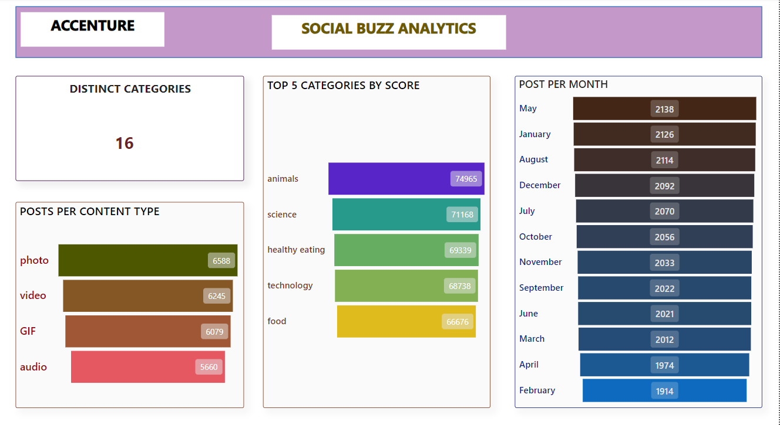

Slide 9
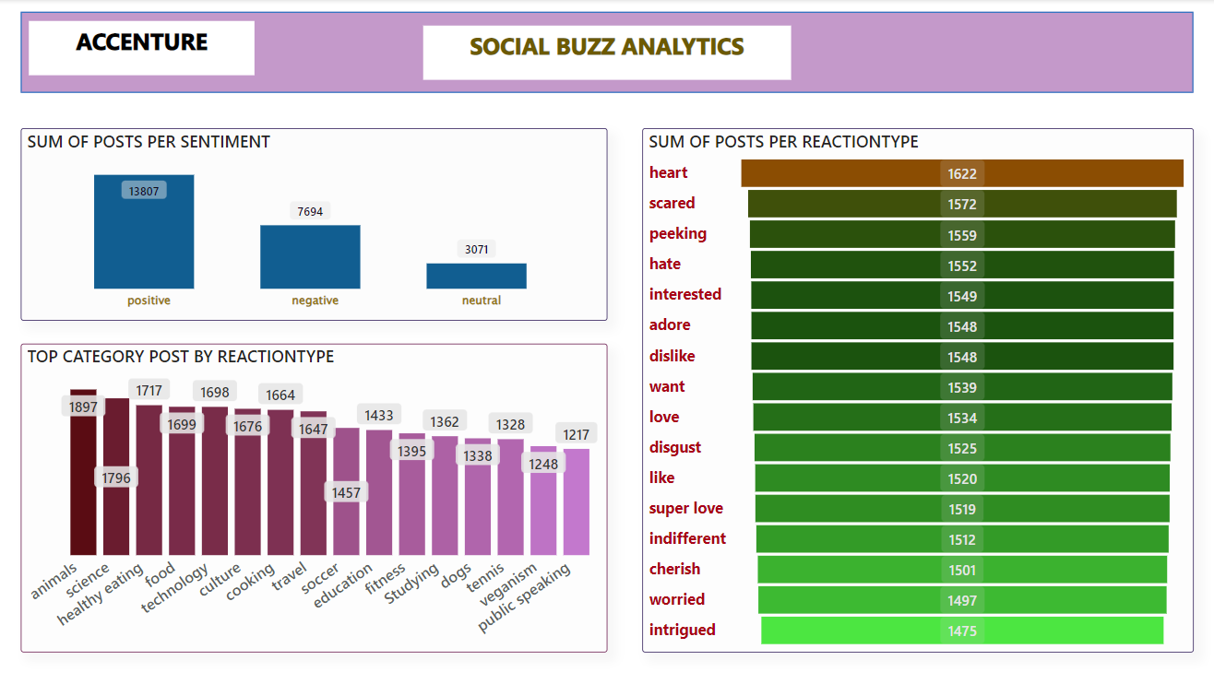

Slide 10

Based on our analysis, we have identified the top 5 categories with the highest scores. Among these categories, "animals" and "science" stand out as the most two popular topics in terms of content in social buzz.
This valuable information can be utilized by social buzz platforms to curate and deliver more content related to these categories to engage their audience effectively.
Additionally, we observed that the most commonly shared content type is "photos", Social buzz can capitalize on this by producing more visually appealing content, and the "heart" reaction is the most frequently given by users. Moreover, the post related to "animals" received the highest number of reactions, specifically 1897 reactions. .
Summary

Slide 11
Thank you!
ANY QUESTIONS?

